Slide 1
Design and Development of Applications
for Mobile Devices
Sensors
Semester 1, 2019

Slide 2
Mobile going forward
This week will discussing sensors and camera
Next week is the last week of content for the paper
Lab work and marks
Assignments

Slide 3
What are Android sensors?
Measures motion, orientation, etc
Provide high accuracy and precision
Practical example would be calculating moisture in a room
Notes:
Some of these sensors are hardware-based and some are software-based
Hardware-based sensors are physical components built into a handset or tablet device
Software-based sensors are not physical devices, although they mimic hardware-based sensors. They are often called virtual sensors
Most Android-based devices have in built-sensors that measure motion, orientation and various environmental conditions such as light and humidity.
Useful for three dimensional movement or positioning (X, Y, Z) and you will be looking at this is the practical later on
You can use your phones temperature and humidity sensor

Slide 4
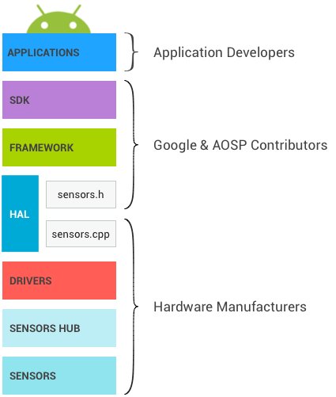
Sensor stack
What are the components???
Notes:
Each component communicates only with the components directly above and below it.
Control flows from the applications down to the sensors, and data flows from the sensors up to the applications.
Components
Applications
SDK – applications component accesses sensors through the Sensors SDK API.
Framework – the Android framework
HAL – is the interface between the hardware drivers and the Android framework. The HAL consist of an interface (sensors.h) and implementation (sensors.cpp). Most native libraries are written in C and C++ for obvious performance
Drivers – interacts with the physical devices.
Sensors Hub
Sensors – the physical MEMs chips making the measurements. In many cases, several physical sensors are present on the same chip.

Slide 5
Sensor types
Motion sensors
Environmental sensors
Position sensors
Raw sensors vs Composite sensors
Notes:
Motion sensors measure acceleration forces and rotational forces along three axes – accelerometers, gravity sensors and gyroscopes
Environmental sensors measure air temperature and pressure, light and humidity – barometers and thermometers
Position sensors measure the physical position of a device – orientation and magnetometers

Slide 6
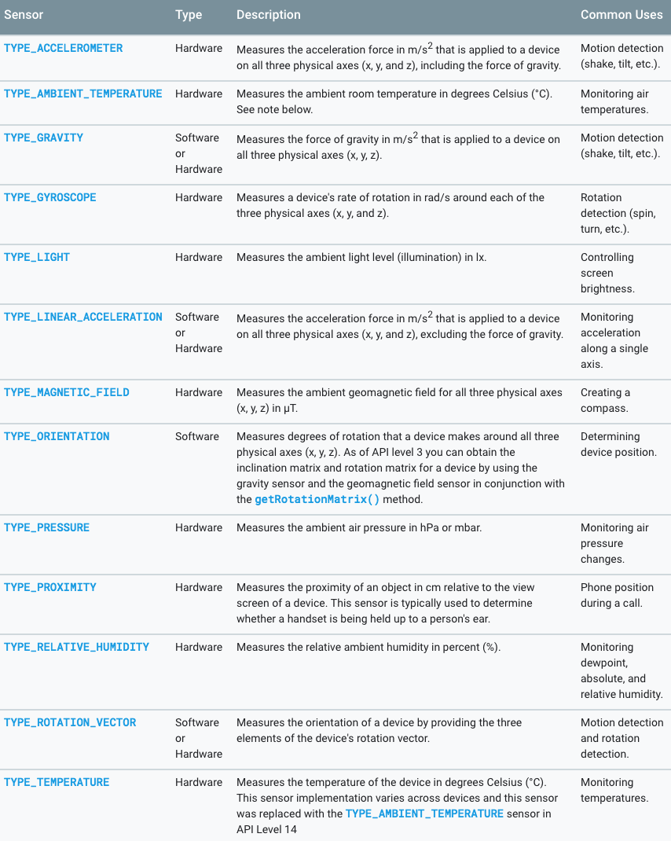
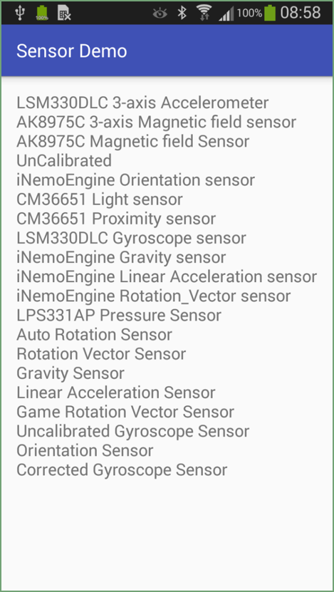
List of sensors

Slide 7
Best practices for accessing and using sensors
There are five best practices that you should consider:
Unregister sensor listeners
Do not block the onSensorChanged() method
Avoid using deprecated methods or sensor types
Verify sensors before you use them
Choose sensor delays carefully
Notes:
You want to make sure to disable your sensors that you don’t need or use, especially when your app is not in use. Failing to do so can drain your battery in a few hours
Just want to point out that the system will not disable sensors automatically when the screen turns off
Sensor data can change at a high rate, which means the system may call the onSensorChanged() method quite often. If you are calling different sensors in the onSensorChanged() method, you will block it. It best to do as little as possible
As of last year, there are several methods and constants that have deprecated. For example, the TYPE_ORIENTATION sensor type has been deprecated
Always verify that a sensor exists on a device before you attempt to acquire data from it. Don't assume that a sensor exists simply because it's a frequently-used sensor.
You should always verify that a sensor exists on a device before you attempt to get data from it. Don’t assume that sensor exists because because it's a frequently-used sensor. You may have a phone that is six or seven years. It is likely that it doesn’t have modern in-built sensors
Sensors can provide data at very high rates. You want to allow the system to send extra so you don’t waste system resources and batter power

Slide 8
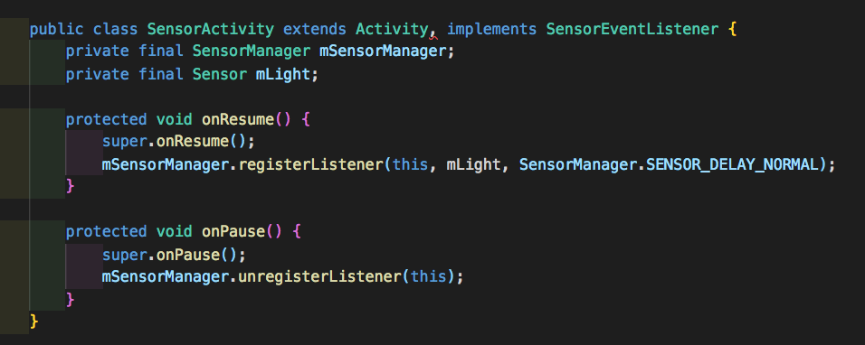
Unregister sensor listeners
Notes:
SensorManager – class that provides various methods for accessing and listing sensors, registering and unregistering sensor events
SENSOR_DELAY_FASTEST - 0 microsecond SENSOR_DELAY_GAME - 20,000 microsecond SENSOR_DELAY_UI - 60,000 microsecond SENSOR_DELAY_NORMAL - 200,000 microseconds(200 milliseconds)

Slide 9
Lab 1: Sensor Exploration (Groups)
In lab 1, you will be explore the accelerometer, light and proximity sensors. Open up Android Studio and create a new application.

Slide 10
Lab 1: Sensor Exploration (Groups) Continue
Implement the following functionality:
List all the sensors on your phone
Display the X, Y and Z tilt values using the accelerometer sensor
If you have a light sensor, display the illumination level and values as you move your phone from light to dark
If you have a proximity sensor, display “Near” when the phone is < 5cm from a surface (e.g. your hand) and “Far” when the phone is > 5cm from surface

Slide 11
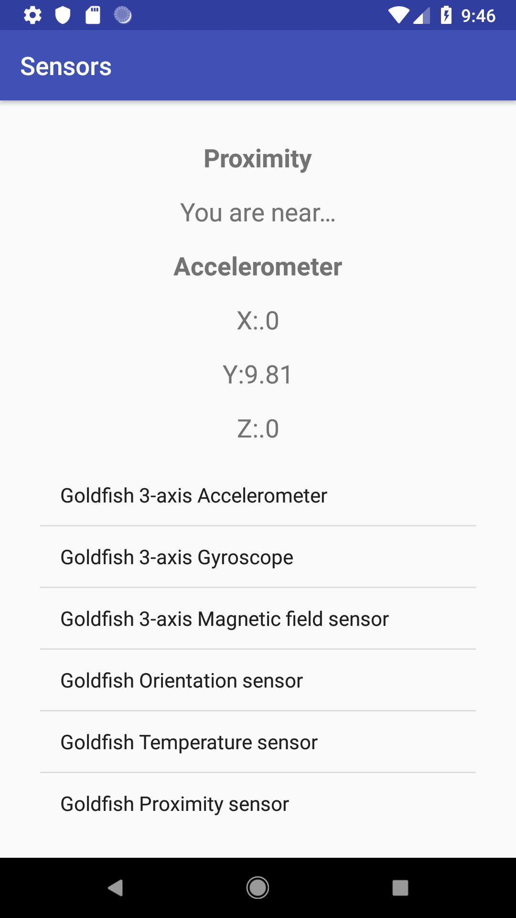
Lab 1: Sensor Exploration (Groups) Example

Slide 12
Lab 2: Sensor Animation (Individual)
Implement the following functionality:
Create an animation that responds to tilting on the X and Y axis
Link to sensors overview
http://developer.android.com/guide/topics/sensors/sensors_overview.html

Slide 13
Please take note
There are examples online where the sensor event handlers are written as part of the activity. Please do not do this. Instead, implement your event handler as inner classes.
Provide correct handlers for the onPause() and onResume() methods.
If you are unsure, refer to the code snippet on slide eight.

